Slide 1
2208-CSE-6321-001-ADVANCED AUTOMATION TESTING
Team 1 Team Members List :-
1. Naman Sannan (UTA ID – 1001690640)
2. Nigel Dsouza (UTA ID – 100175944)
3. Parakh Rajan(UTA ID – 1001768389)
4. Kavya Gudivada (UTA ID – 1001766005)
5. Amey Dhuri (UTA ID – 1001641844)
6. Vratant K Chauhan(UTA ID – 1001769484)

Slide 2
Task Assigned
TASK | NAME
Registration, Validation for Registration | Vratant K Chauhan
Passenger Login, Validation for Login, Passenger Homepage | Nigel Dsouza
Passenger Event Summary, Passenger Select List, Logout | Naman Sannan
Coordinator Login, Logout, Homepage Links | Parakh Rajan
Manager Login, Manager Homepage Links | Kavya Sri Gudivada
Manager Event Summary, Manager Select List , Manager Logout | Amey Dhuri
ITERATION 1

Slide 3
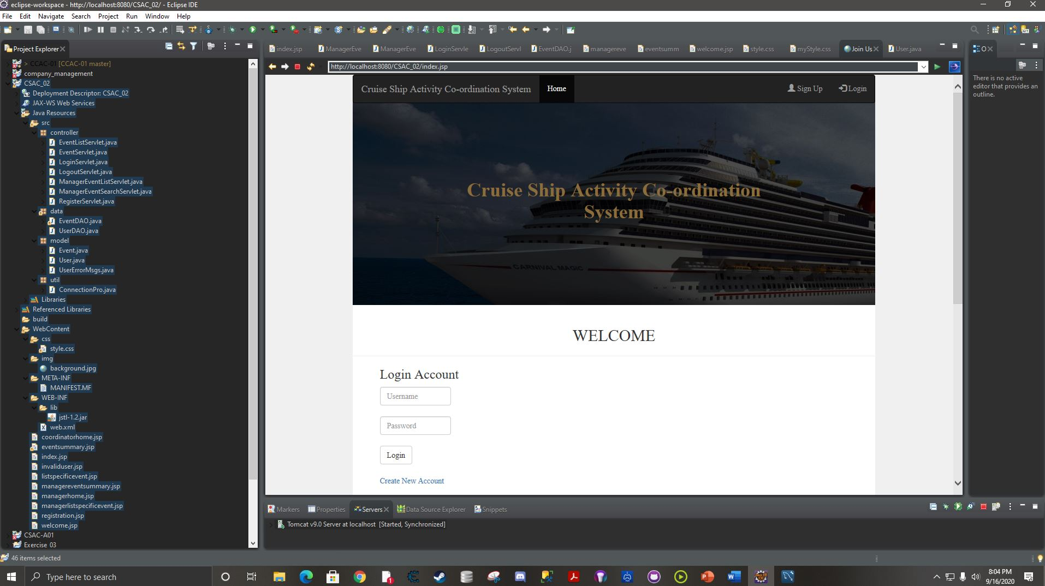
screenshot
ITERATION 1

